Slide 1

Cyber etymology
SIDDAGANGA INSTITUTE OF TECHNOLOGY
BROWSE ‘17
A game of scrabble for it geeks

Slide 2
rules
Each team can have maximum of 3 members.
The game comprises of “ROUNDS” and has a total of 5 Rounds.
FIVE teams will be playing at a time.

Slide 3
rules
Each team will be given a character, one at a time i.e. one for each round.
That team should frame a word related only to Electronics and Computers, which is considered as a technical term.
The words which are not considered technical will be REJECTED.

Slide 4
rules
The word should NOT be ;
Plurals.
Proper Nouns.
Acronyms.
-ing / -ed ending.(continuous / past verb.)
White Spaces is also not Allowed.(eg : Data Structures)

Slide 5
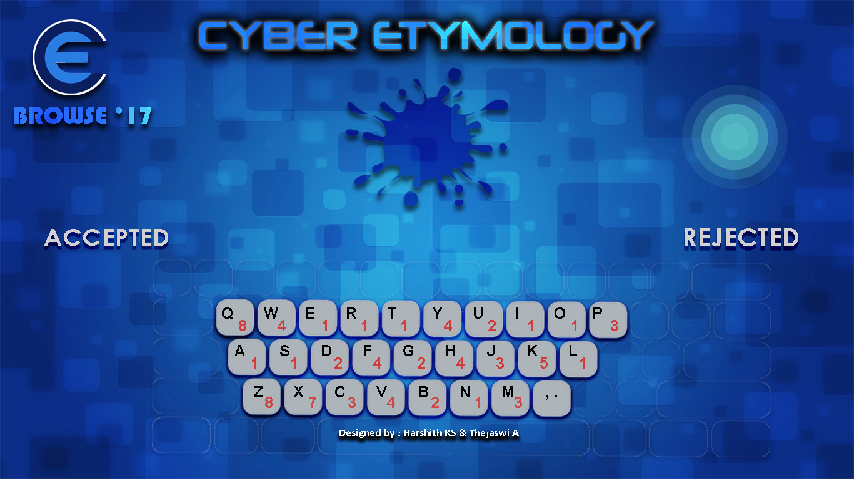
The interface
15
This is the region where the character is displayed…
You will have only 15 secs to frame and send the word.

Slide 6
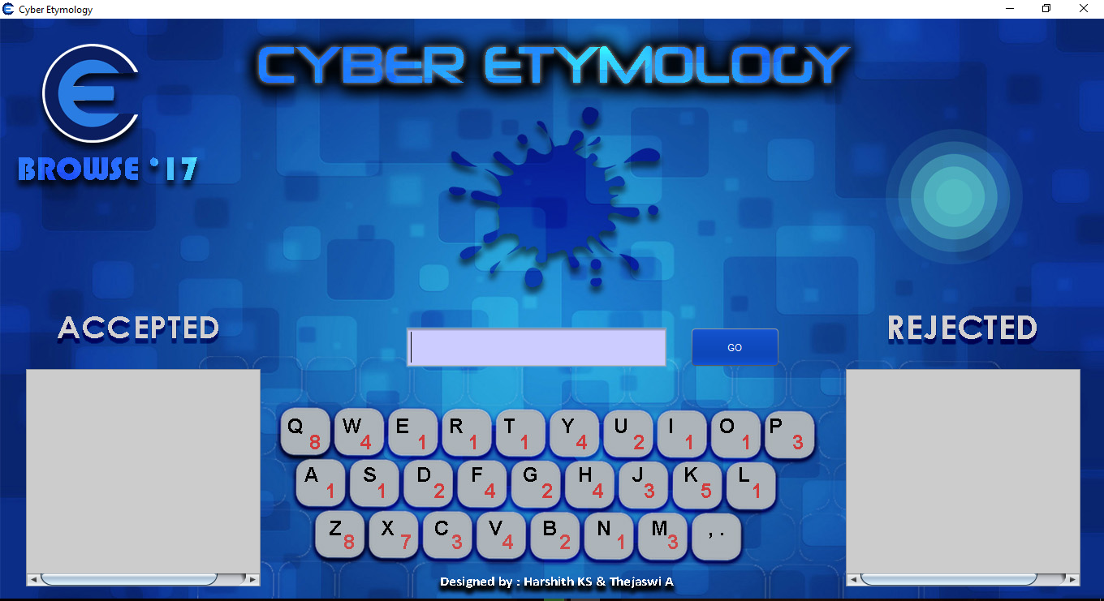
The interface
Type your word in this text box and either press ENTER or click the
“GO” button.
7
Before the time runs out.
recursion
Multithread
JavaScript
Kernel
Macintosh
Machine learning
Formatted
Searching

Slide 7
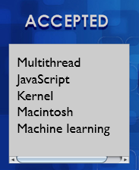
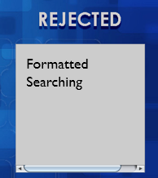
The interface
If the word is accepted , it will appear in this box.
If it is rejected, the word will pop in this box.
Also, keep an eye on the ACCEPTED list to avoid word duplication.
(i.e. if the word is already present in the list, the entered word will be rejected. )

Slide 8
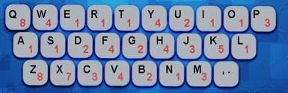
A particular weight is assigned to each character.
The score of the valid word framed will be calculated by summing up the values of each character in it.
For ex : If the entered word is JAVA, then its score will be calculated as,
J A V A
= 6
3 + 1 + 1 + 1
Refer this keypad displayed on your screen to know the weights of each character in your word.

Slide 9
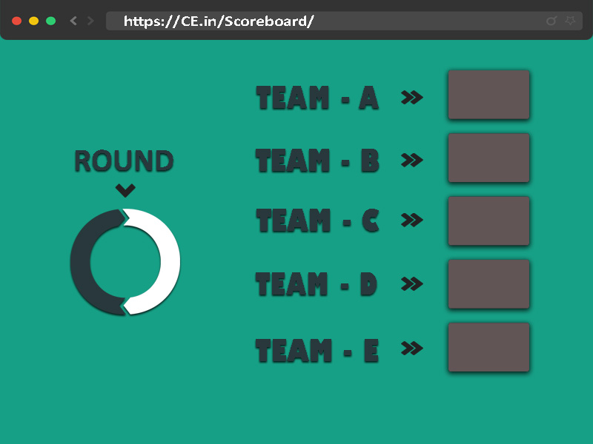
The total team score after Each Round will be displayed here.
TWO teams with the highest score will automatically qualify for the next EXTENAL ROUND.
TEAM SCORE
24
10
35
2
26
7

Slide 10
At the end…
JUDGE’s decision will be final.
Any attempt to revolt against the JUDGE’s decision or not following the instructions given by the VOLUNTEERS may lead to INSTANT DISQUALIFICATION of that team.

Slide 11
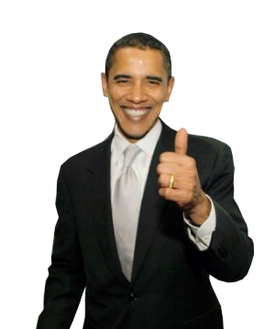

GOOD LUCK !

